Slide 1
FFT Audio Visualizer
Rehan Iqbal
Yogesh Dhada
Meng Lei

Slide 2
Block Diagram
Audio Input (Nexys4 Microphone)
audio demo
FFT
Image Control
VGA Display
Picoblaze
Nexys4_RGB_if
DTG
pushbuttons

Slide 3
Audio_demo
Dedicated ADC on Nexys4DDR board samples at 3MHz
Provides PDM output of sample

Slide 4
Audio_demo: main I/O
.clk_i
.pdm_clk_o
.clk_6_144MHz
.data_mic_valid
.pdm_data_i
.data_mic
.pdm_lrsel_o
pdm_filter

Slide 5
pdm_filter: main I/O
.clk_i
.pdm_clk_o
.clk_6_144MHz
.fs_o
.pdm_data_i
.data_o

Slide 6
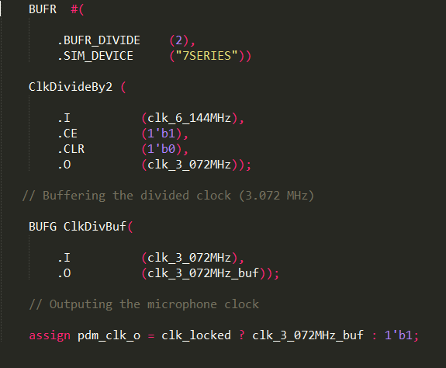
Dividing the 6.144MHz clock for 3.072MHz

Slide 7
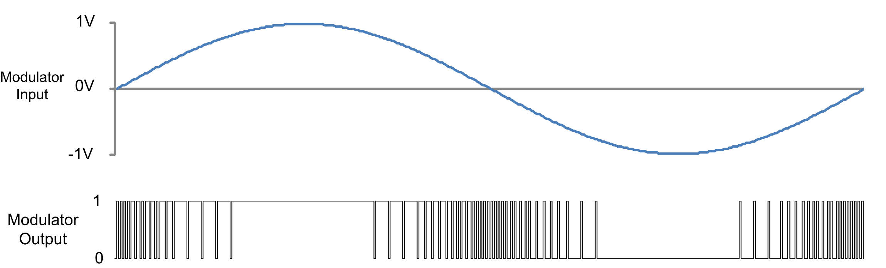
Pulse Density Modulation
Increasing number of 1’s as signal amplitude increases

Slide 8
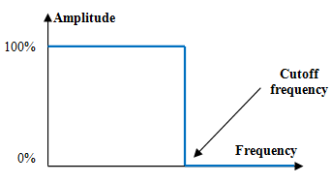
PDM Filter
Noise Problem:
Crappy mic
4 filter stages
CIC Filter
Highband filter
Lowpass filter
Highpass filter
Low-pass FIR filter
Notes:
CIC works 192Khz
Second stage: Halfband filter with decimation ratio of 2 and input -- sampling frequency of 192 kHz, resulting in a 96 kHz output sample rate.
Low pass filter: sampling rate 96KHz
HighPass 96KHz removing DC component

Slide 9
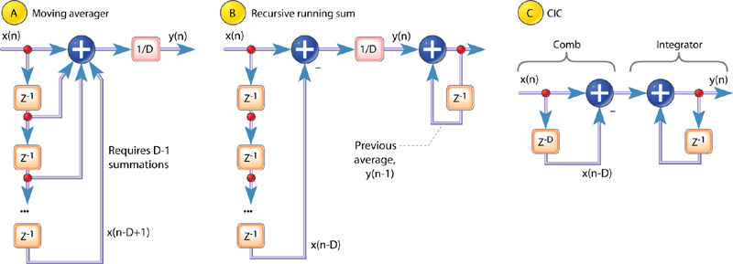
CIC Filter:
A twist on the recursive running-sum filter
Which is a twist on the moving average

Slide 10
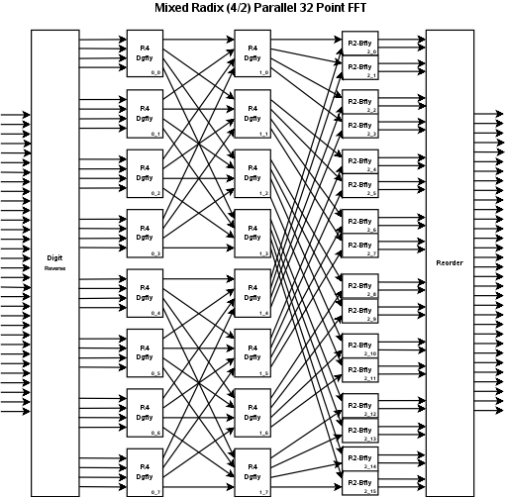
Fast Fourier Transform
Use Cooley–Tukey FFT algorithm to split Discrete Fourier Transform into multiple smaller DFT’s
This reduces operation order from O (n ^ 2) to O( n * log n )
Multiple forms: different radices, butterfly options, etc.
Lends itself to parallel computation

Slide 11
First attempt: use HLS to implement
Multiple high-level synthesis (HLS) tools available:
System Generator: design and simulate using Simulink blocks specifically made for Vivao
HDL Coder: write MATLAB code or design Simulink and convert to HDL
Vivado HLS: write C code and convert to HDL
Need to compare generated HDL against original model
Fixed point conversion issues
Checking whether it’s accurate enough
Simulation speed (co-simulate on board possible)

Slide 12
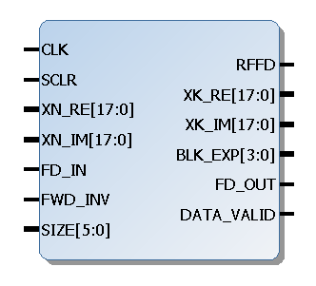
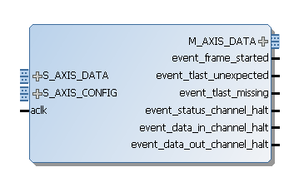
Two Vivado IP cores available
Discrete Fourier Transform
Fast Fourier Transform

Slide 13
ImgControl
Similar to icon.v from Project 2
Store FFT samples in a block RAM
As pixel goes across screen, read memory to find FFT power reading for that bin
Based on vertical position and power, determine whether to draw or not

